Slide 1
Financial and Management accounting: A symbiotic relationship How US PTO uses both in price setting….
Sander den Hartog & Lim Vermeer
CEO of CostPerform and Subject matter expert at US PTO

Slide 2
Agenda
About CostPerform
Financial accounting vs Management accounting
How to come to cost price modelling using both principles
Maturity levels in combining both actuals (financial accounting) and normative accounting
About US PTO
Cost Modelling at US PTO
Maturity evolvement at US PTO

Slide 3
CostPerform Info

Slide 4
Our vision
All organizations will need cost transparency either internally or externally. The abundance of data availability will only grow.

Slide 5
Our mission
Making the tools to help you understand and improve the performance of your organisation.

Slide 6
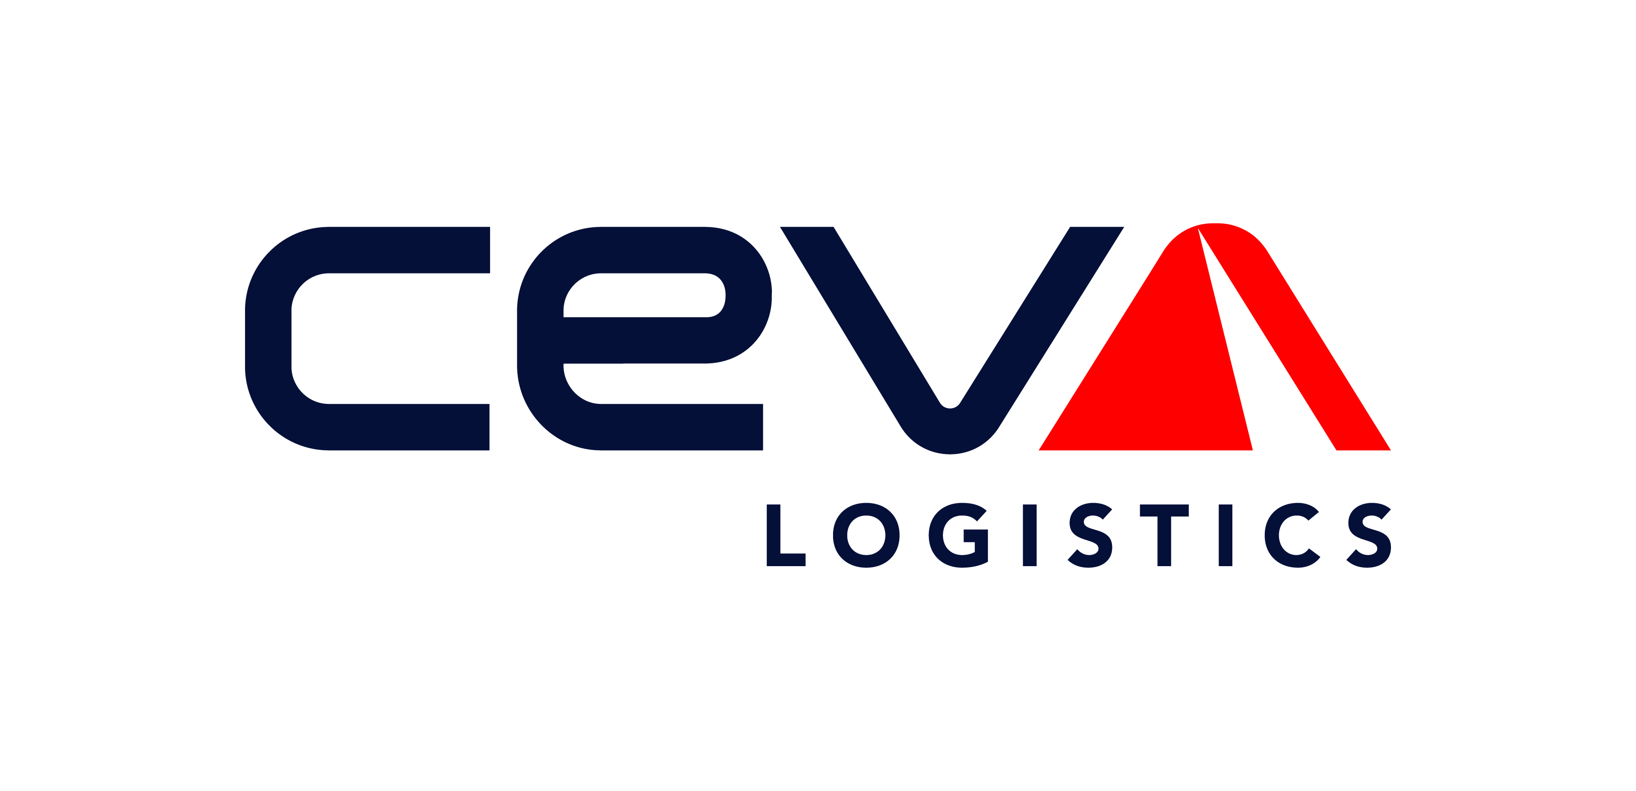
A sample of our clients
Malta
Notes:
Tevreden

Slide 7
OUR BELIEFS ON COSTING:
1
2
3
Organizations will grow in costing maturity
Automation and repeatability is key
Access to costing info should be broad within the organization

Slide 8
Product modules to Mature, Automate and lower barriers
Client
Financial processes
Operational processes
Regulatory processes
Collecting your financial and operational data
Mapping your data to your organization and creating insights
The calculated results are presented as actionable information for all involved stakeholders.
Data collection
Data Modelling
Actionable information
ETL
Extract, transform and load data from all sources and in all formats.
Modelling functionalities
(TD)ABC, Multidimensional costing, capacity aware models, (conditional) distributions, Loop allocations, etc, etc.
Predefined reports
Unit cost breakdowns, recharge reports / invoices, Feeder / Bleeder analysis, etc.
API
Open to inject and extract data using the API editor.
Standard templates
Full TBM Taxonomy for IT costing, Cost to Serve, IFRS17 for insurance, etc.
Self service reporting
Full trace back / forward up at every model object, Scenario analysis, allocation grid visualisations, etc.
Data entry portal
Let the organization upload and validate data.
Modelling validations
Cost flow checks, Driver sensitivity, missing links, obsolete cost objects, user defined validations, etc.
Connection to external tooling
Predefined plug-ins for Tableau, PowerBI, QlickSense / View, ETL to other databases, OLAP reporting of allocation pathways, etc.
Notes:
Dit is onze waarde propositie bestaand uit deze 9 blokken. 1e blok heft te maken met beliefs rondom repeatability, 2e blok met maturity en 3e met spread. Zie de beliefs op slide 8

Slide 9
Most common CostPerform use cases
Product / Customer Profitability
Quickly and systematically identify value leakage. Understand the true cost to serve as well as underlying product profitability
TBM (IT chargeback)
Financial Management of IT departments. Enabling discussions between IT and business. Proving the value of IT through transparent chargebacks and bill of IT.
Regulatory Reporting
Produce Regulatory Financial statements in a controlled timely manner. CostPerform provides stakeholders with confidence through transparent evaluation and analysis.
Budgeting and Forecasting and scenario analysis
Fully incorporated and used into existing budgeting and forecasting processes. Quickly run scenarios and impact analysis on expected market returns. Controlled methodology changes are easier to track with CostPerform.
Transfer Charges / Corporate allocations
Ensure a fair and transparent allocation of internal transfer charges.
Cost to Serve
Calculate your logistic cost from your manufacturing facility to your final customer

Slide 10
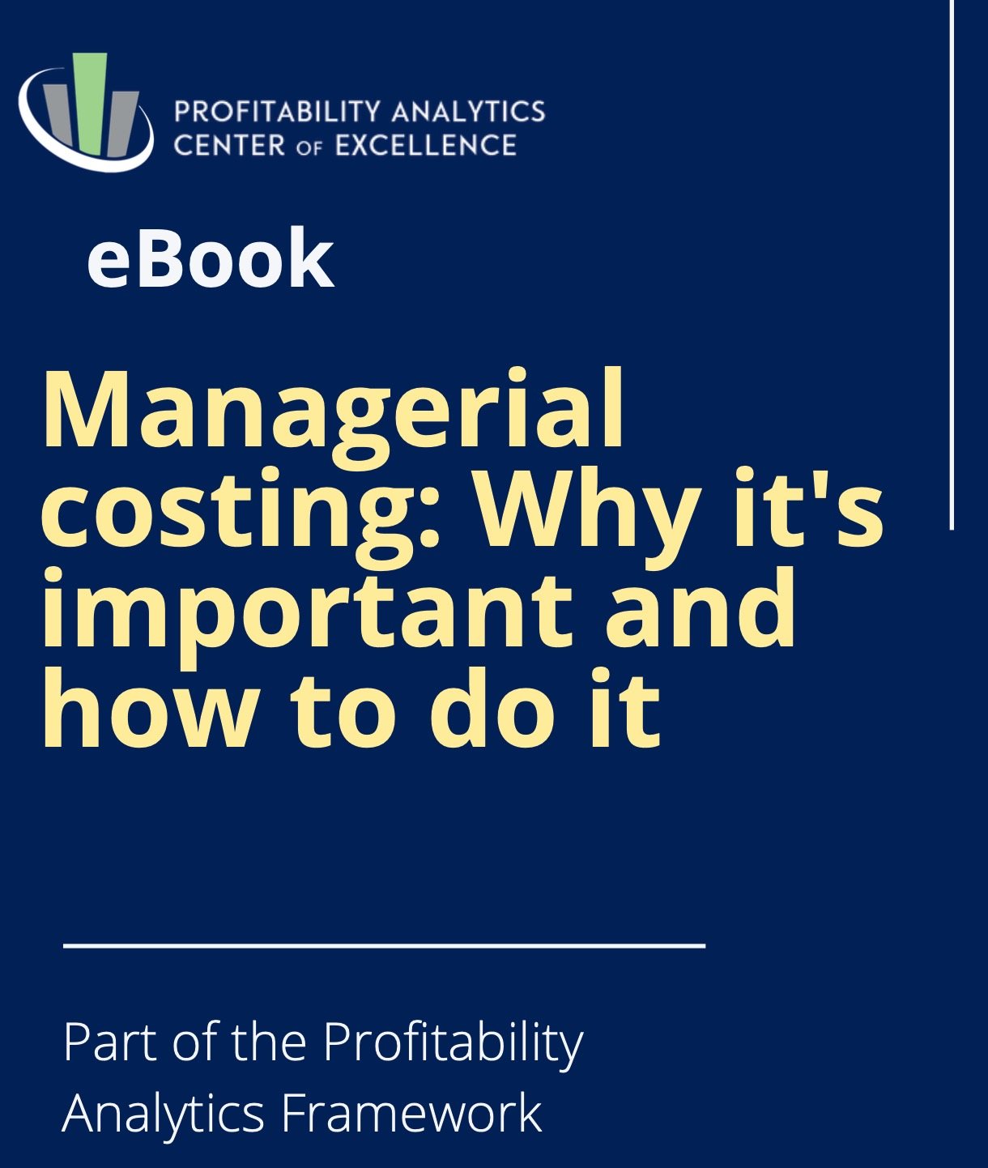
Managerial costing
Managerial costing is costing done to provide accurate and relevant cost information for internal decision support.
No mandated rules or standards but principles and concepts.
Grounded in causality
Differs from financial accounting
IN CONFIDENCE

Slide 11
Financial accounting vs. Managerial Costing
Issue | Financial accounting | Managerial costing
Principles | Revenue recognition Historical Cost Matching | Causality - Cause and Effect Analogy – Logical use of information to reflect operations
Perspective | Backward looking Focus on specific time periods Sunk costs are relevant Profit is paramount | Forward looking Focus on continuum of operations Sunk costs are irrelevant Cash flow is paramount
Depreciation | Time or Use based on historical costs | Capital preservation allowance based on replacement value and future resource needs
Cost Objects | 1 dimension: usually products | Products, Services, customers, Channels, etc. All dimensions that have a causal cost relation.
Sales, Marketing and any other general/overhead costs | Identified at organizational level | As causality dictates

Slide 12
“Identify the differences between cost price, tariffs / sales prices and prices on the invoice
Cost prices to tariffs
Revenue
Standardizing
Tariffs policies
INPUT
(source systems)
Cost price model
Output
(cost prices)
Output
(normalized cost prices)
Tariffs
(sales prices)
Invoice
Management principles
Assumptions/estimates
Laws and regulations
Matching financial administration HR systems Prodcution systems | Use of generally accepted economic principle for allocation of costs and revenue Applying the applicable law and regulations around cost management Transparent substantiation and documentation | Insightful structure of the cost price Using pre- and post calculation in cost prices Using under – and overcapacity Multiyear averages Setting ambitions | Clear policies arround tarifs that can be linked to strategy Using mark-ups (for risks, profit, innovation, etc) | Governance of the salesforce Using input for contract negotiations

Slide 13
Cost flows in Managerial costing
Cost
Resources
Activities
Products

Slide 14
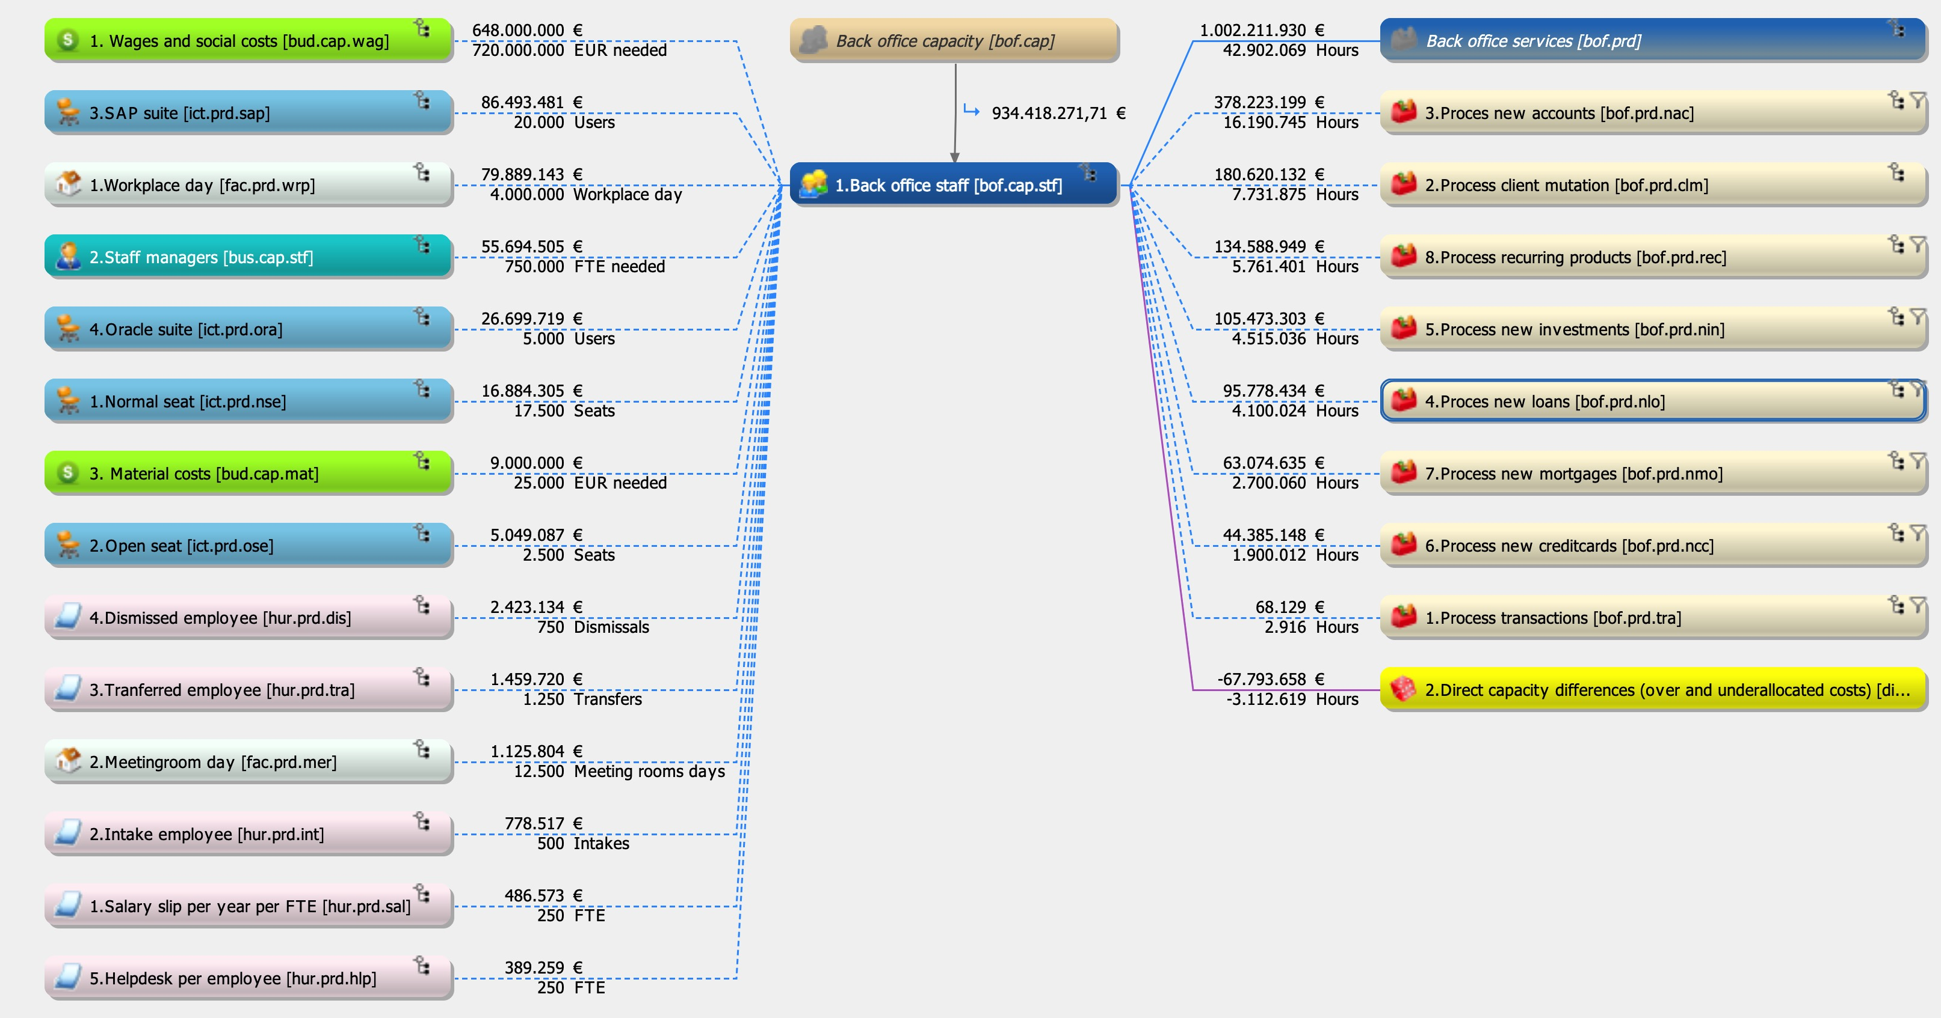
CostPerform Example 1

Slide 15
How to meet financial accounting (example)
Cost
Resources
Activities
Products

Slide 16
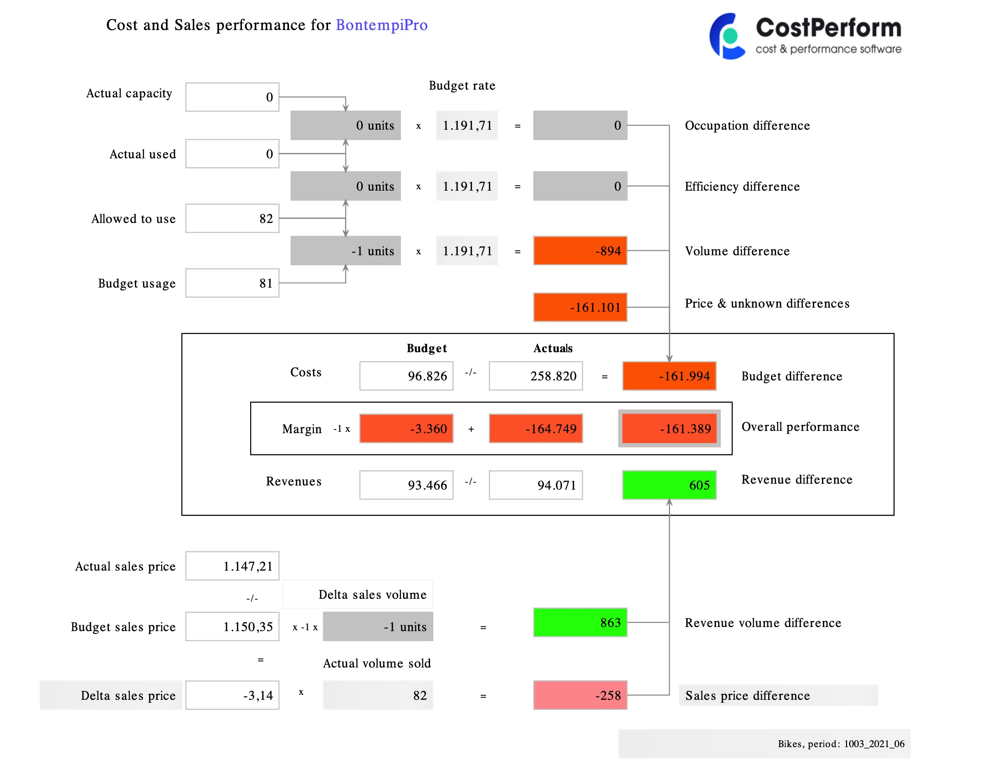
CostPerform Example 2

Slide 17
Profitability Analytics
The point where Revenue Management, Investment Management and Managerial Costing intersect
Managerial Costing
Profitability Analytics
Revenue Management
Investment Management
17

